Slide 1
Advanced Systems Analysis and Design Quality Reviews SOFT 30121 L23 Presented By Nigel King ACMA CGMA PCM Nigel.King@ntu.ac.uk

Slide 2
Summary of Last Lecture

Slide 3







Quality
Which of these brands suggest quality?
Why?

Slide 4
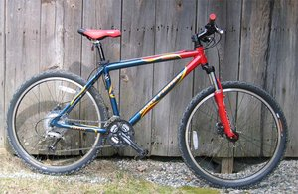
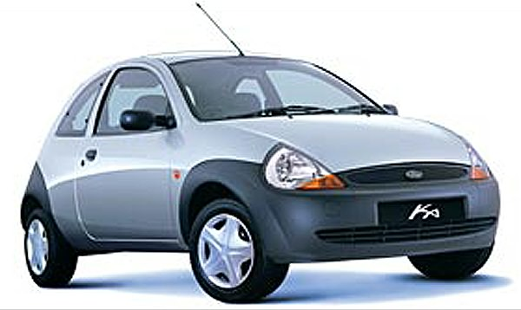

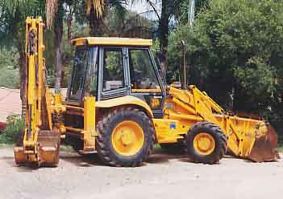
Which of these is highest quality?

Slide 5
Quality = Fitness for purpose
Purpose may include functional and non-functional aspects
Functional?
Does X, does Y, will not do Z
Non-functional?
Costs £A, lasts B years, is available in C months
Which of these apply to the images on the last 2 slides?
Can you think of any others?

Slide 6
What does quality mean?
Primary aspects for the customer:
Does the correct job
Does the job correctly
These may imply other quality aspects:
Reliable
Fast enough
With the minimum of user interaction
Without generating side effects
…
How can these be ensured, verified?
By constructing a methodology that ensures quality in techniques and therefore (by inference) in the products.

Slide 7
Quality Standards?
Quality systems like ISO9001 help to document the way you ensure the quality – forcing a company to define policies, objectives, staffing, resources, documentation etc. aimed at achieving quality (see ref 1, 8)
‏
Very high level – ensure the documents exist…

Slide 8
Lots of Standards…
ISO 9000 is a group of standards for quality (not just software) (see ref 7)
Eg ISO 9000-2005 defines “Quality management systems -- Fundamentals and vocabulary“
Whereas ISO 10014 – 2006 is about “Quality management -- Guidelines for realizing financial and economic benefits“ (counts as ISO 9000 family!)
A large proportion of organisations gaining ISO 9001 accreditation are in the service sector!
More specific to software are:
ISO 10007-2003 “Quality management systems -- Guidelines for configuration management”
ISO 9126-4:2004 “Software engineering -- Product quality -- Part 4: Quality in use metrics”
ISO 25000 series - Software Engineering -- Software product Quality Requirements and Evaluation (SQuaRE)

Slide 9
ISO 9126
Covers the quality elements ending “ity”! (see wikipedia reference for summary)
Functionality
Suitability
Accuracy
Interoperability
Compliance
Security
Reliability
Maturity
Recoverability
Fault tolerance
Usability
Learnability
Understandability
Operability
Efficiency
Maintainability
Stability
Analyzability
Changeability
Testability
Portability

Slide 10
Personal Software Process (ref 4)
A system developed by Carnegie-Mellon to help engineers individually to:
Improve their estimating and planning skills.
Make commitments they can keep.
Manage the quality of their projects.
Reduce the number of defects in their work.

Slide 11
PSP Body of Knowledge
Foundational Knowledge
Basic PSP Concepts
Size Measuring and Estimating
Making and Tracking Project Plans
Planning and Tracking Software Quality
Software Design
Process Extensions and Customizations

Slide 12
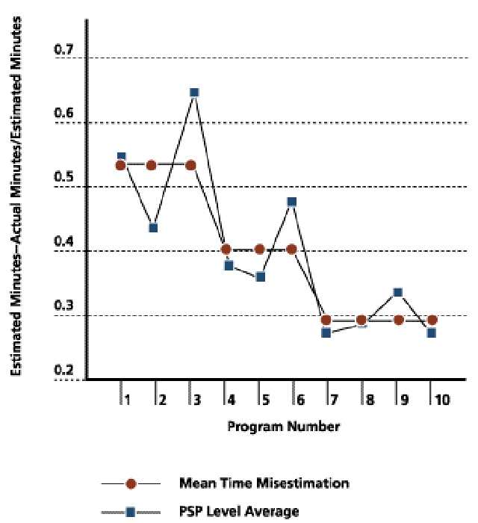
Early experiments -Show that as engineers ‘improved’, their estimations more closely matched the actual times taken to implement.
However, note scale of estimation in minutes…

Slide 13
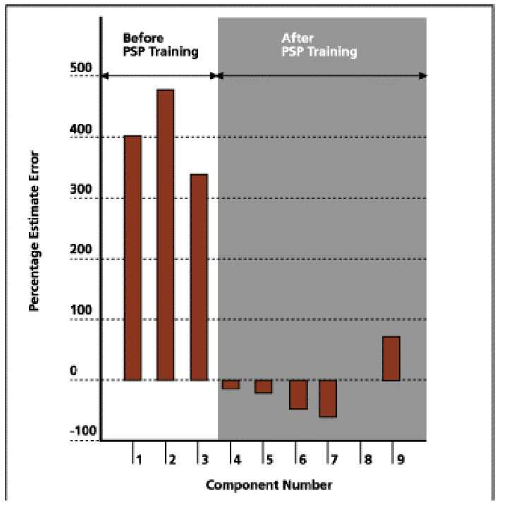
A slight snag…
It DOESN’T mean the software took less time, just that engineers were more realistic!

Slide 14
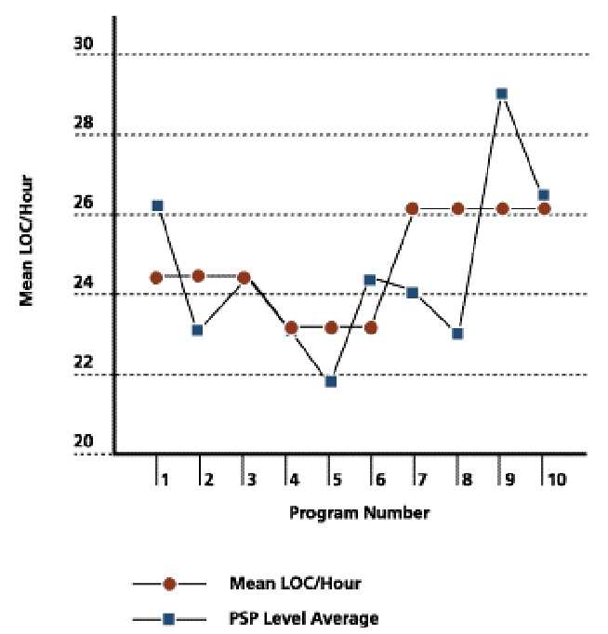
Note that the rate of code production was not very different before/after
However recent examples suggest that engineers better at producing quality products after such training

Slide 15
PSP works in evolutionary way
Introduces process discipline and measurement
Introduces estimating and planning
Introduces quality management and design
Combines with Team Software Process.
“TSP provides a defined process framework for managing, tracking and reporting the team's progress.” (ref 5)‏

Slide 16
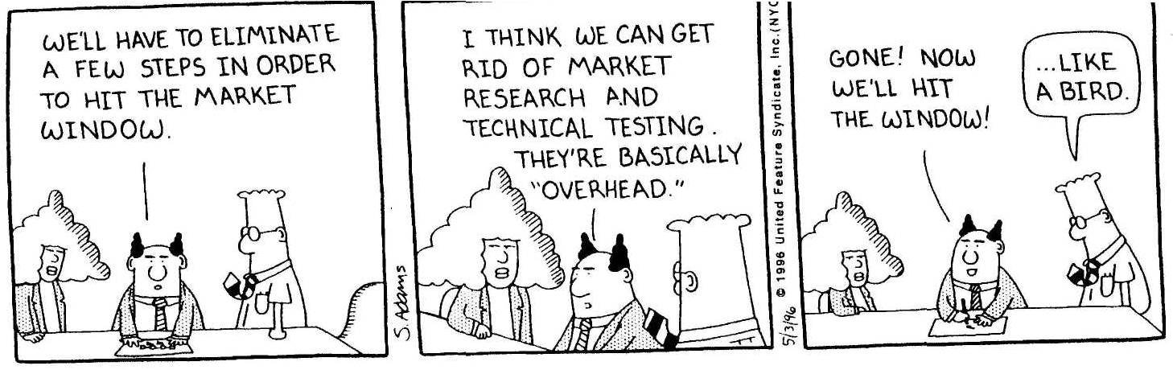
Tries to avoid the following:

Slide 17
Example of PSP – ‘Post-Mortem’
A postmortem analysis of the work conducted at the completion of a phase or project provides valuable information, including
updated project data for time, size, defects, and schedule (actual, to-date, and to-date %)
updated calculations for quality or performance data
a review of performance against the plan
updated historical databases for size and productivity
process adjustments needed, based on personal data (notes made on process improvement proposal (PIP) forms, changes in design or code review checklists indicated by defects that escaped a phase, and so on)

Slide 18
Other techniques…
Mid lifecycle:
Design reviews
Fagan reviews
(Entry and Exit Criteria)
Automated design metrics
(Test for each feature)
Later lifecycle:
Coding standards
Code reviews
Automated code metrics
Automated testing
Test planning, specification
Regression testing
Early lifecycle:
Formalised Estimation
Requirements walkthroughs
Formal specifications
Planning (covered in project management)‏

Slide 19
References
1. http://praxiom.com/iso-9001.htm - ISO 9001 2000 TRANSLATED INTO PLAIN ENGLISH
2. http://www.dilbert.com/ - an essential guide!
3. http://www.sei.cmu.edu/cmmi/
4. http://www.sei.cmu.edu/reports/09sr018.pdf
5. http://www.sei.cmu.edu/news-at-sei/features/1999/jun/Background.jun99.pdf - “Pathways to Process Maturity”
6. http://www.sei.cmu.edu/tsp/tsp.html - team software process
7. www.iso.org
8. http://en.wikipedia.org/wiki/Iso_9000

Slide 20
Onward to Demoes

